Slide 1
Rosetta Stone Manager v3 Online
Feb 2013

Slide 2
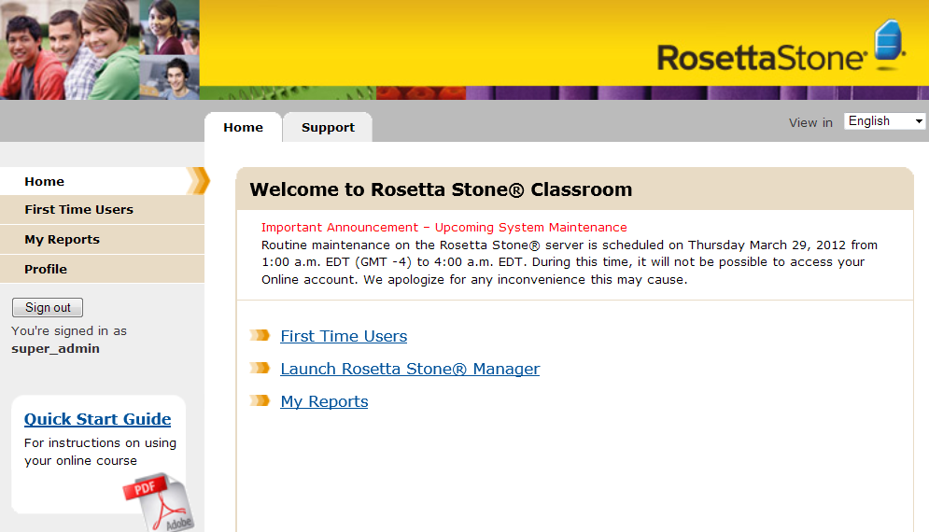
Rosetta Stone Manager
Data Management
Rosetta Stone Manager: A system for managing Language Learning and Reporting on Learner progress
Rosetta Stone features powerful administrative tools and reporting functionality to:
  Manage and Measure your Learners’ progress
  Ensuring program
  consistency
  Providing quantifiable
  measurements of Learner
  success

Slide 3
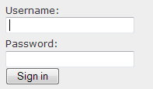
Rosetta Stone Manager
Logging on
Type in your account web-address: https://barstowusd.rosettastoneclassroom.com
Enter your Admin Username and Password provided by your Super Administrator
Select Sign In

Slide 4

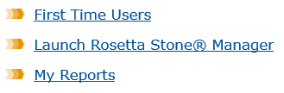
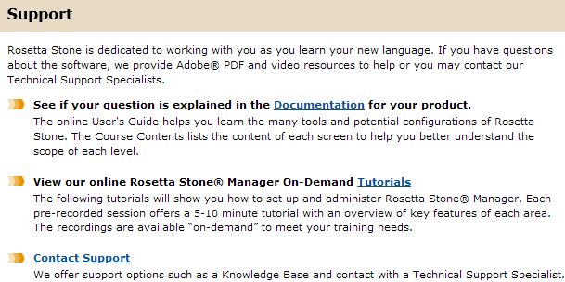
Rosetta Stone Manager
Tools on Portal
Home tab
  First Time Users: videos about Rosetta Stone methodology and how to maneuver the program
  Launch Rosetta Stone® Manager
  Reports: quickly view reports as a PDF or Excel sheet
Support tab
  Rosetta Stone Manager Guide
  Rosetta Stone User’s Guide
  Course Contents
  Tutorials
  Contact Support

Slide 5
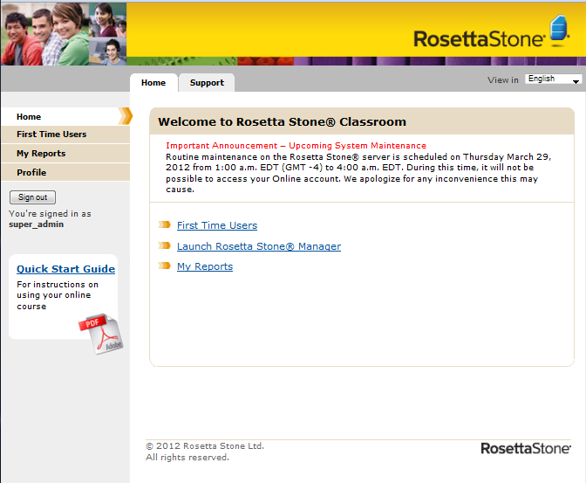
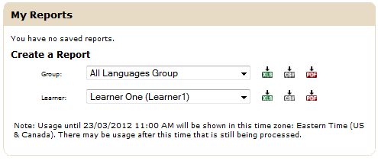
Rosetta Stone Manager
Direct Access to Reports
View Select Group’s Usage in Excel
View Learners’ Summary Reports
View Learner Curriculum Report in Excel
View Learner Curriculum Report as PDF

Slide 6
Rosetta Stone Manager
Setting up
Group Structure (Hierarchy)
Administrators
Learner Registration (Consider Curriculum)
Smart Lists (vs. Custom Lists)
Dashboard Reports (List Curriculum Reports)
Additional Reports

Slide 7
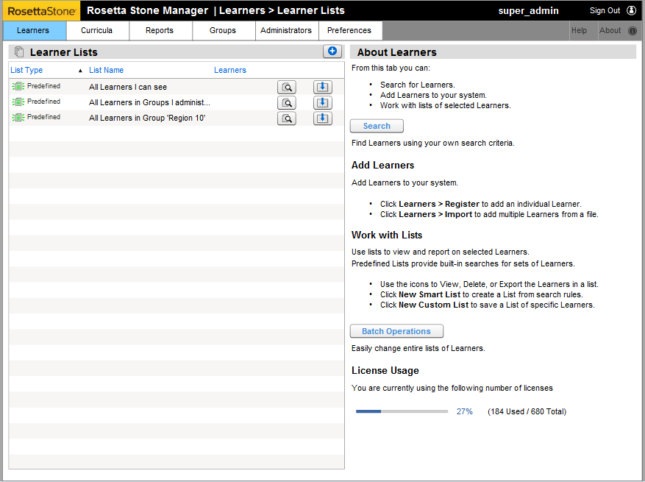
Rosetta Stone Manager
Home Page

Slide 8
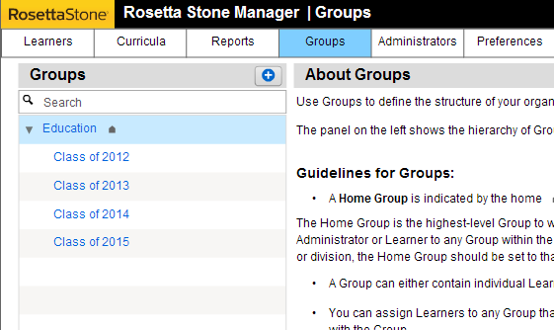
Rosetta Stone Manager
Group Structure
Click on the Groups tab to see the structure of your school.

Slide 9
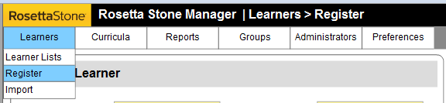
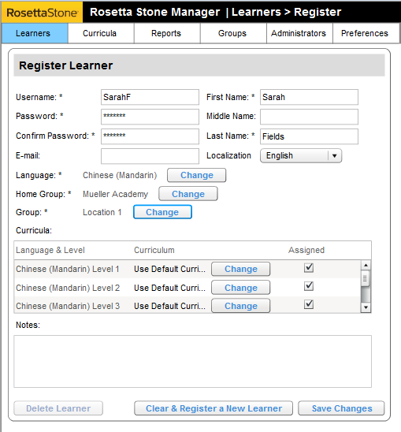
Rosetta Stone Manager
Registering a Learner
Click Learners tab, then select Register
Fill out the boxes highlighted with yellow
  *Each Username needs to be unique to the Learner
Language is the language the Learner is learning
Home Group is always Top Level
Select the Group the Learner belongs (i.e. Class of 2012)
You may add any information to the Notes field (i.e. Teacher’s name) this information can be used to create a Smart List later
Then select Save Changes
Once saved, click Clear & Register a New Learner to add another Learner

Slide 10
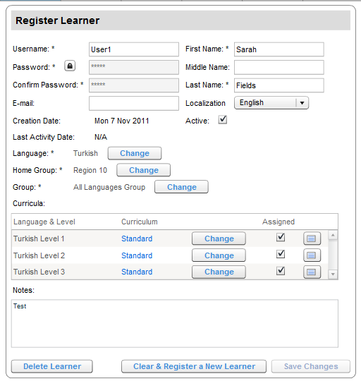
Rosetta Stone Manager
Learner Details
Click to reset the Password
Check and uncheck the box to Activate/Deactivate an existing Learner
Click to quickly view an individual learner report
Click to Change Curriculum for this Learner

Slide 11
Rosetta Stone Manager
Learner’s Lists
Smart Lists
Can be used to view and run reports on a specific list of Learners
Is dynamic in the fact that it will update itself when a Learner is added or removed from your RSM that meets the criteria you set when creating the List
Custom Lists
Can be used to store a list of Learners
Will not update – Static List

Slide 12
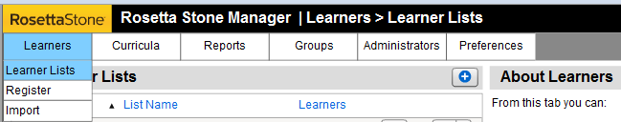
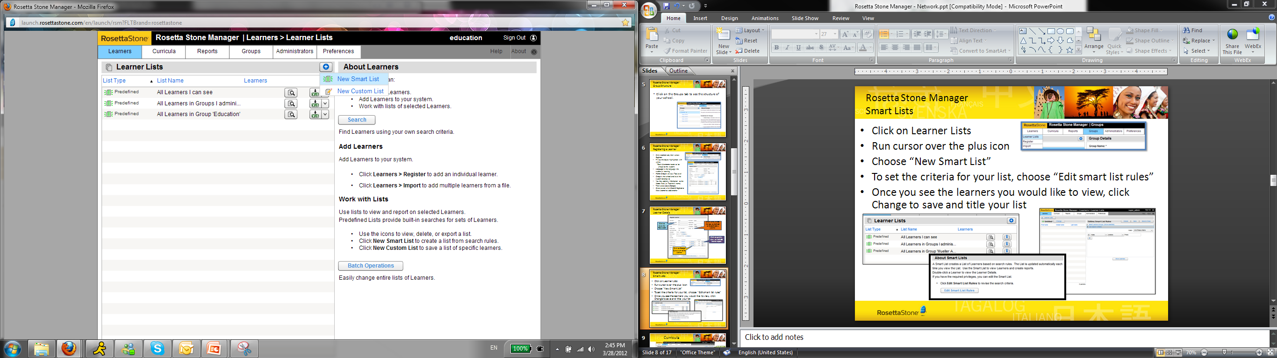
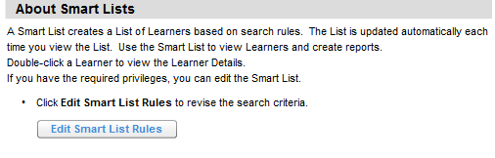

Rosetta Stone Manager
Smart Lists
1. Click on Learner Lists
Smart Lists are used to differentiate your Learners. Most reports are run using Smart/Predefined Lists
2. Run cursor over the plus icon
Choose “New Smart List”
3. To set the criteria for your list,
choose Edit Smart List Rules
4. Once you see the Learners you would like to view, click Change to save and title your list

Slide 13
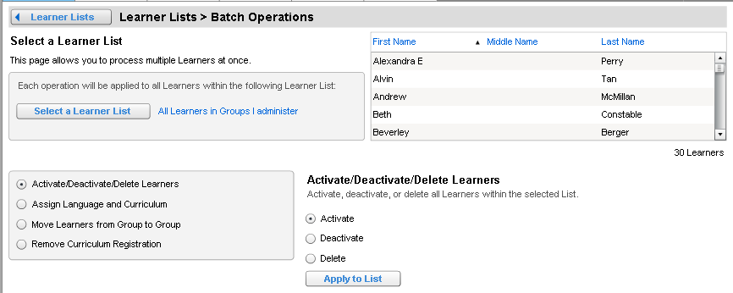
Rosetta Stone Manager
Batch Operations
Batch Operations allows you to perform certain functions to an entire Smart List of Learners, such as Deactivation or moving learners from one Group to another.

Slide 14
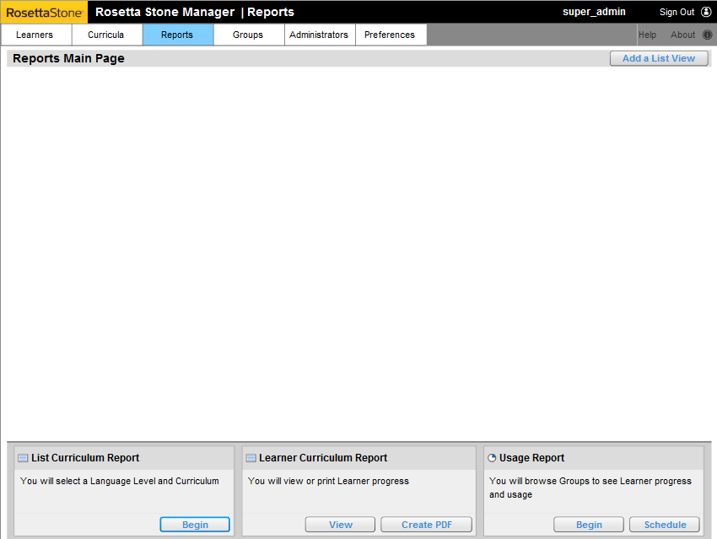
Rosetta Stone Manager
Reports
Save List Curriculum reports, that are important to you, on your reports home page.
Use the List Curriculum Report to run a report based on your predefined, Smart, or Custom Lists
The Learner Curriculum Report lets you view individual Learner progress and scores.
View Group usage with a Usage Report; you can see the overall time spent in Rosetta Stone

Slide 15
Rosetta Stone Manager
What kind of report do I need?
List Curriculum Report
A report that shows learner summaries and group progress
A report that is viewed as a graph
A report that can be saved to the Reports tab in the Rosetta Stone Manager

Slide 16
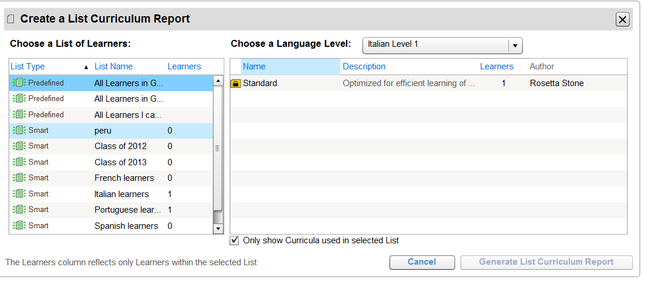
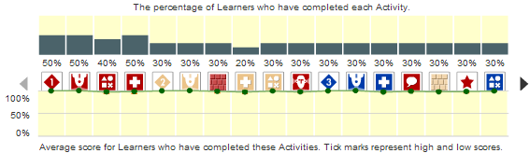
Rosetta Stone Manager
List Curriculum Reports (Dashboard)
1st
2nd
3rd
4th
Click Reports
To see the progress of your Learners and the average percentages:
  Click Begin under List Curriculum Report
  (1st) Choose one of your Predefined or Smart List options
  (2nd) Next, choose the Language and Level.
  (3rd) Next choose Curriculum
  (4th) Finally click Generate List Curriculum Report

Slide 17

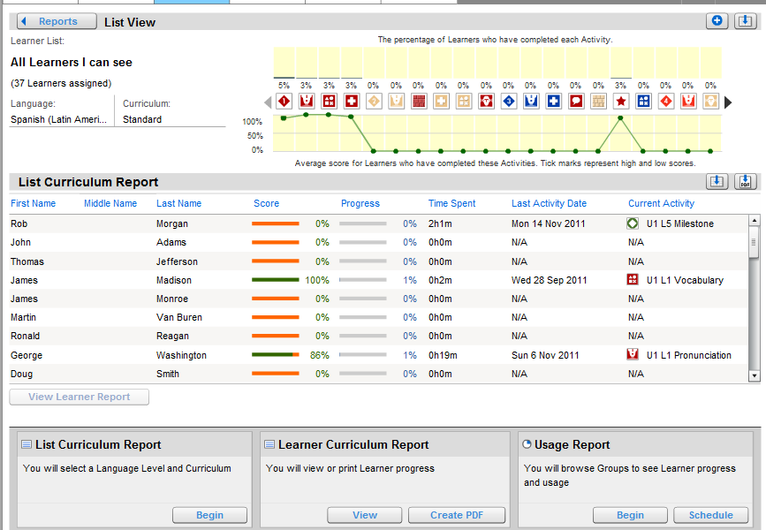
Rosetta Stone Manager
List Curriculum Reports (Export)
Click on Details to expand the Report.
Click here to export this report to Excel or to create a PDF list.

Slide 18
Rosetta Stone Manager
What kind of report do I need?
Learner Curriculum Report
A report that shows documentation of individual Learner progress
A report that presents that the Learner is meeting benchmarks
A report that can be easily accessed and viewed as a PDF
A report that shows time spent in Rosetta Course

Slide 19
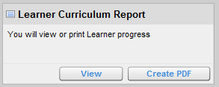
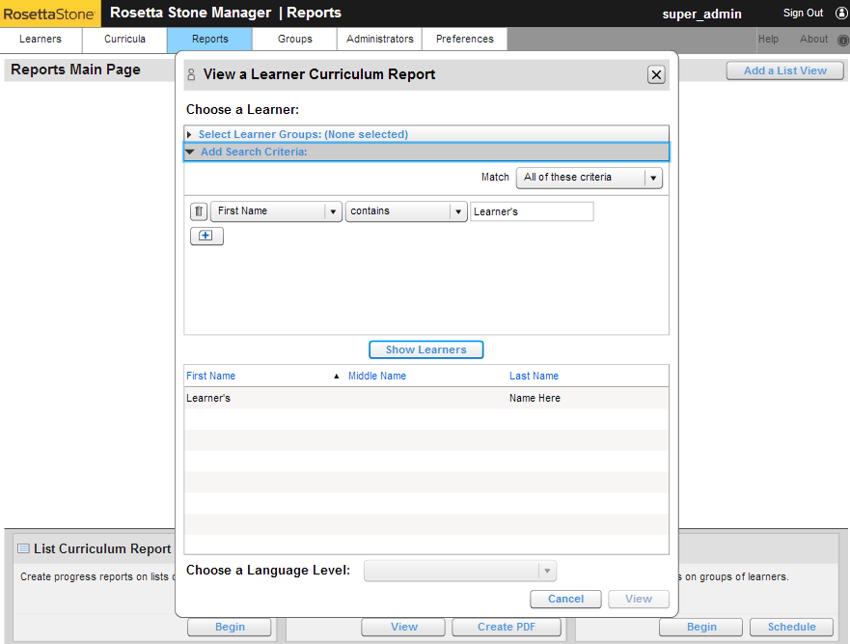
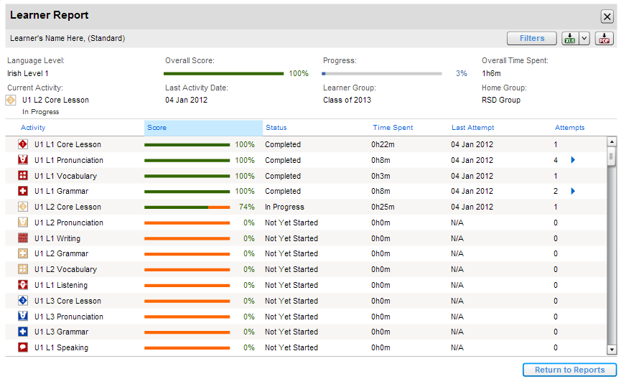
Rosetta Stone Manager
Learner Curriculum Reports
2. Add search criteria
Export to Excel or PDF
1. Choose View under Learner Curriculum Report
3. Choose Show Learners
4. Choose the Learner you would like to see and click View

Slide 20
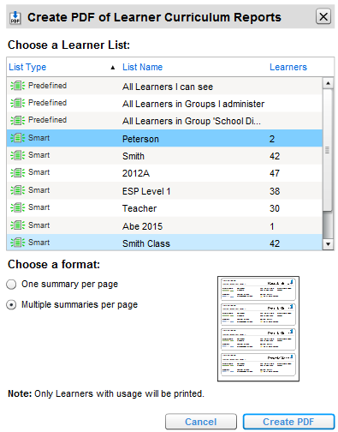
Rosetta Stone Manager
Learner Curriculum Summary Reports
1. Click Create PDF to get started.
2. Select a list of Learners
Having multiple summaries is a tool for sharing information with parents in scenarios such as an open house or parent-teacher conference.
4. Create PDF will allow you to view this PDF Report as well as Print or Save
3. Select here to see one or multiple summaries per page

Slide 21
What kind of report do I need?
Usage Report
A report that shows documentation of time spent in language-learning
A report that presents that the institution is meeting benchmarks
A report that can be easily accessed and manipulated in Excel
A report that shows total time spent in Rosetta Course

Slide 22
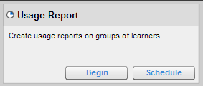
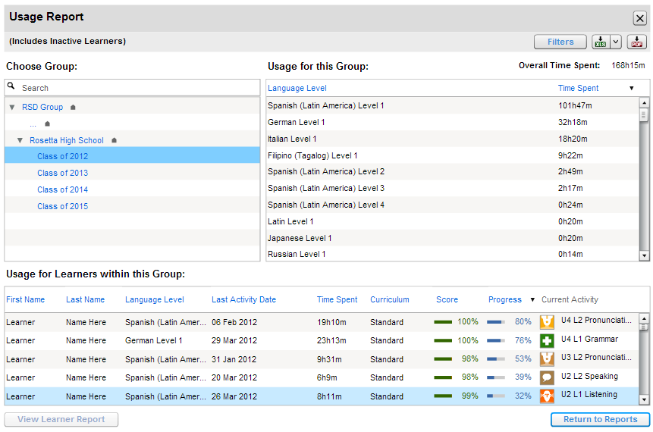
Rosetta Stone Manager
Usage Reports
Usage by language will be shown here
Start by choosing Begin under Usage Report
Choose a Group
Usage by Learner will be shown on the bottom

Slide 23
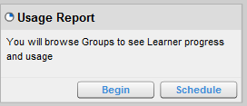
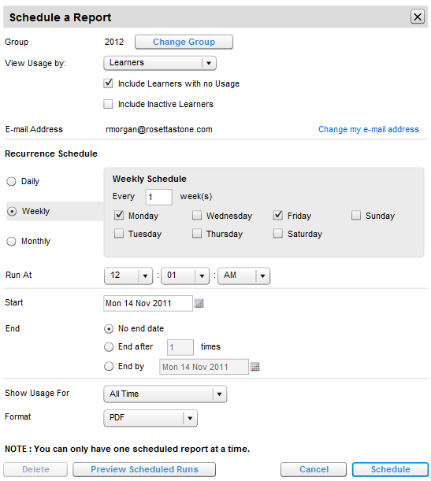
Rosetta Stone Manager
Reoccurring Usage Reports (via email)
2. Select group
3. Select usage view. Choose Learners to view un individual Learner’s usage, or Learners Language, to see the amount of time spent in each language
1. Choose Schedule under Usage Report
4. Choose how frequently you would like to receive the Report
This is a great tool for keeping up-to-date on data and sharing with other Administrators
6. Review information, then choose Schedule to save
5. Select Report format

